Slide 1
PM Review G7T2

Slide 2
1.
FUNCTIONALITIES

Slide 3
Adding Functionalities
Dropping Functionalities
Student: Showing the courses that the students have completed
Able to display enrolled courses and current bids in Dashboard timetable.
Log out, Go back
None at the moment

Slide 4
Completed Functionalities
Login (student & admin)
Bootstrap (admin)
Drop a bid (student)
Add a bid (student)

Slide 5
Ip address 18.218.67.64
Admin password: qwerty123
Notes:
Give a title for this?

Slide 6
2.
SCHEDULE

Slide 7
Iteration 1 (16-29th Sept W5-W6)
Goals: Login Functionality + 1 additional function.
Milestones: PM review
Bootstrap and Data validation | Sherman-Yizhou
Bidding and login functionalities | Sue-Anne-Giles, Giles-Joshua, Sue-Anne-Joshua
As this is the first iteration, we were still feeling out the capabilities of our members. As such our pairings are quite fluid and we sometimes move members around as necessary.
All members would help to integrate the components during our weekly meetings.

Slide 8
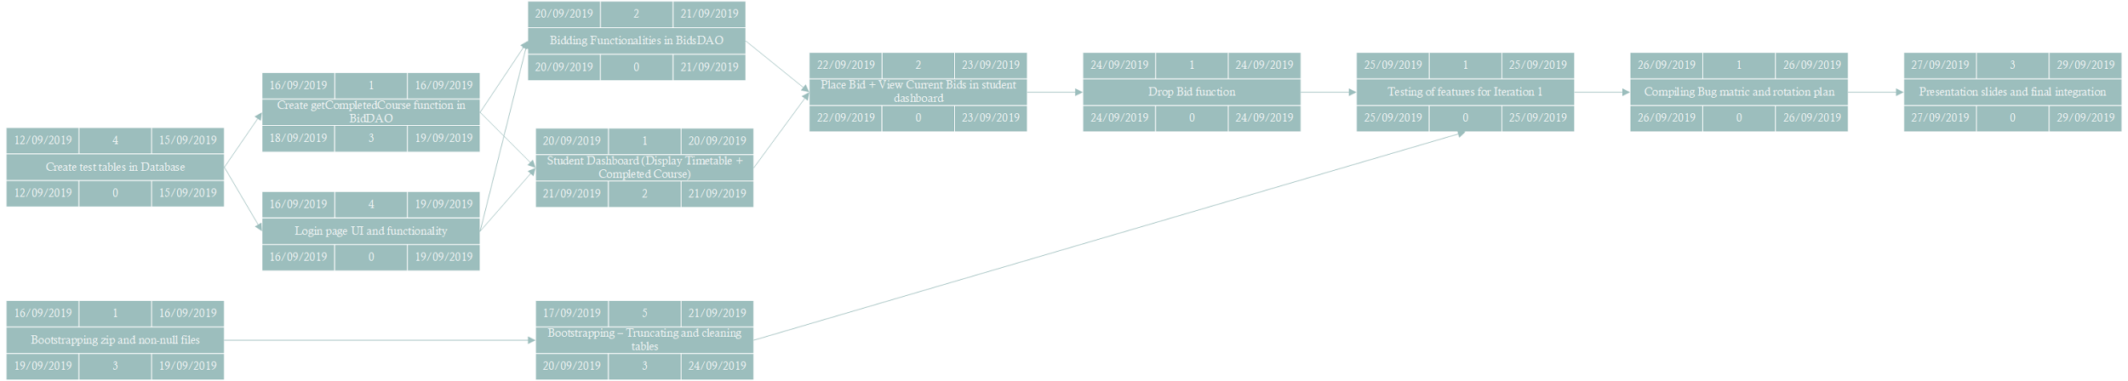
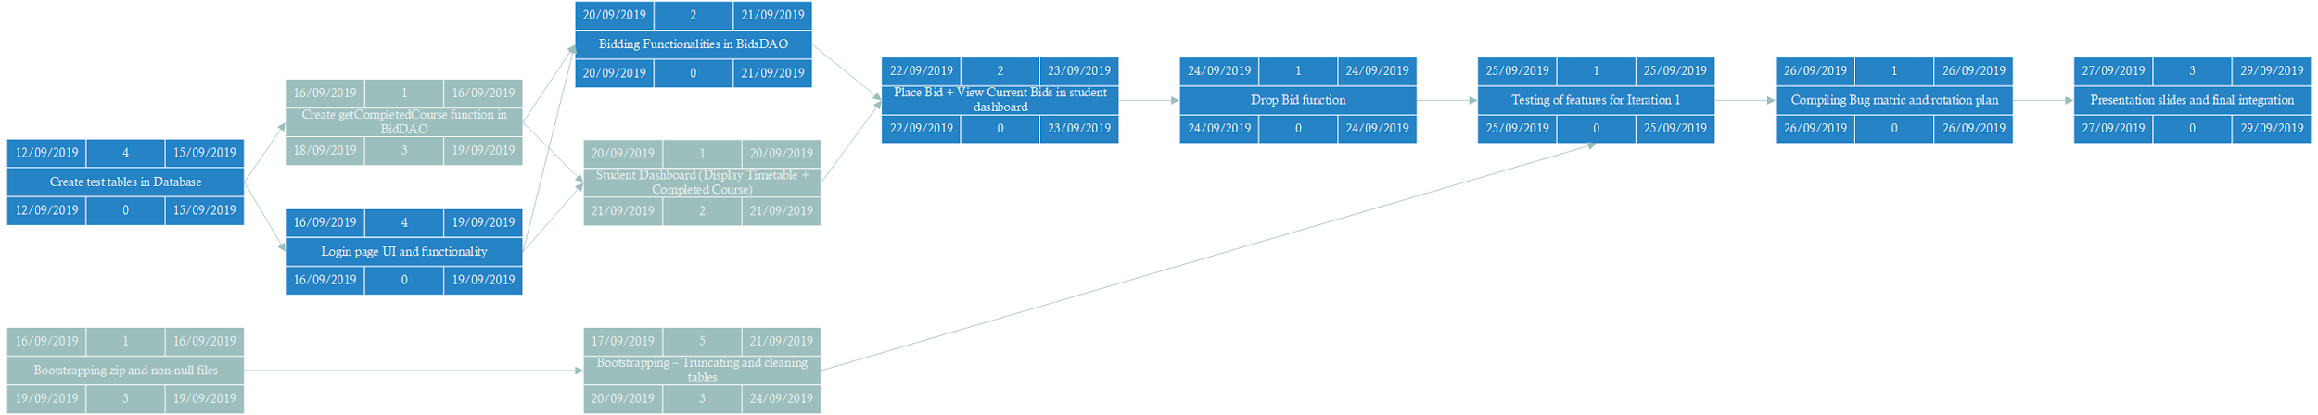
Notes:
Is this meant to be seen?

Slide 9
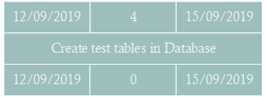
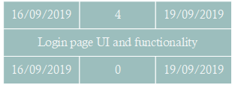
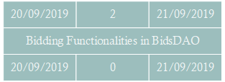
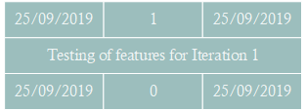
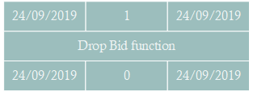
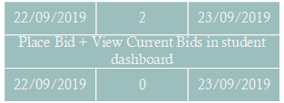
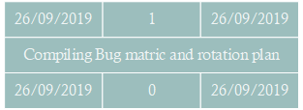
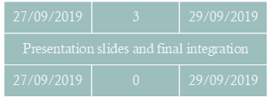
Critical Path

Slide 10
Iteration 2 (30th Sept - 13th Oct W7-W8)
Goals: Working prototype, Improved estimation of schedule and critical path.
Milestone: App demo and progress update
Tasks overview:
Drop section functionality + Display Bidding results (Giles, Sherman)
Implementation of Json test cases + page securities (protect.php) ( Sherman + Joshua)
Setting of rounds by admin + Processing successful bids (Yizhou, Sueanne)

Slide 11
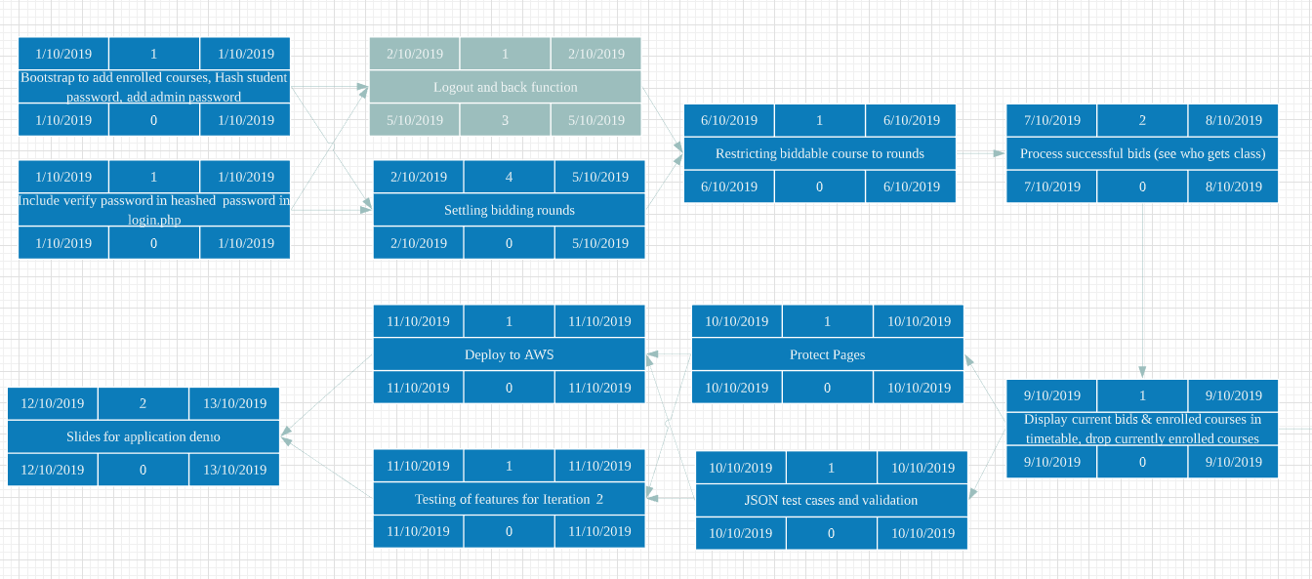
Critical path

Slide 12
Iteration 3 (14th - 27th Oct W9-W10)
Goals: Ensure Application is ready, and deployable on AWS. All functionalities and test cases cleared.
Milestone: User Acceptance Test
Tasks overview:
Cleanup and bug fixing (Sherman, Sueanne)
Integration of app + Create test cases (Joshua Yizhou)
Test locally and cloud (all)

Slide 13
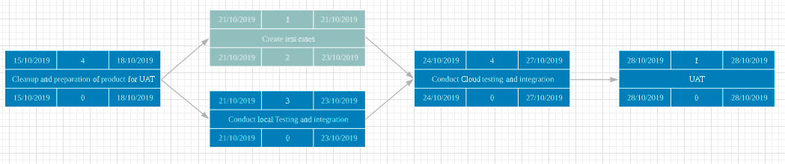
Critical path

Slide 14
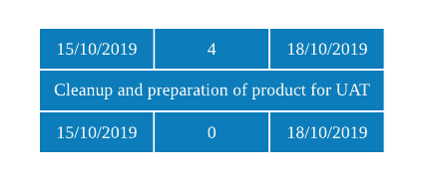
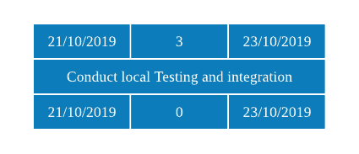
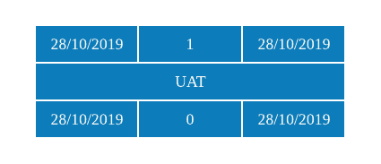
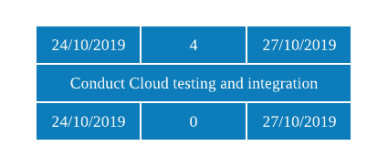
Critical path

Slide 15
Iteration 4 (28th Oct - 10th Nov W11-W12)
Goals: Revise prototype and bug fixing
Milestone: Integrated and revised version of application
Tasks overview:
Compile bugs in UAT, and revise application ( Giles, Sueanne)
Integration of changes and final test ( Joshua, Sherman )
Start on slides for Final Presentation( ALL )

Slide 16
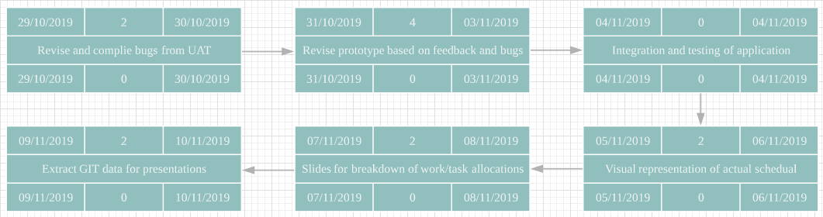
Critical path

Slide 17
Iteration 5 (11th Nov - 24th Nov W13-W14)
Goals: Preparation of final presentation
Milestone: Final presentation
Tasks overview:
Data representation on slides- Git and Schedule (Joshua, sueanne)
Key takeaways and Bugs metric (yizhou , giles)
Rehearse for presentation ( All )

Slide 18
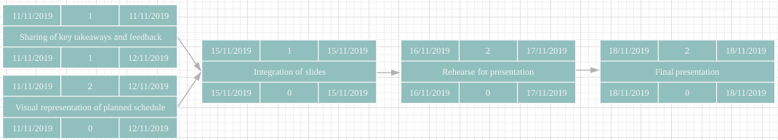

Slide 19
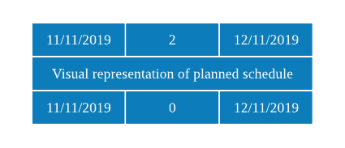
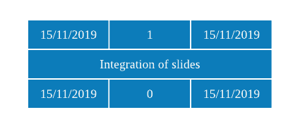
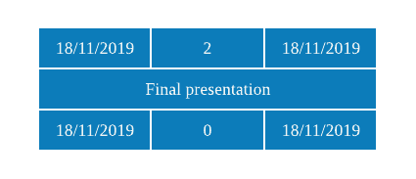
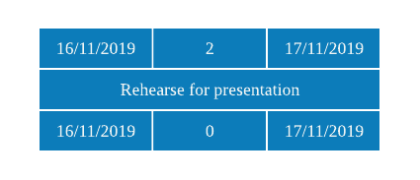
Critical path

Slide 20
3.
BUG METRICS
Notes:
Do we have to show our test cases and compare against expected output?

Slide 21
Bug Metrics
common.php | Include_once starts 2 sessions | Low | 1
bidDAO | Users can still select the same course/selection that they have already successfully bid for | High | 5
bid | "Available courses" still shows courses that user has bid for | High | 5

Slide 22
Bug Metrics
processlogin.php | Functionality now redundant | Low | 1
Bootstrap | Not displaying size of section accurately due to calling wrong variable | Critical | 10
processfile.php | Calling session_start() twice | Low | 1
Bootstrap | Undefined offset warning due to explode function | Critical | 10

Slide 23
Bug Metrics
Bootstrap | Various echo calls being called | Low | 1
Admin | header redirect warnings | Low | 1
Bootstrap | Decimal places in bidding values | Critical | 10

Slide 24
Bug Metrics
Total points: 45
Resolved: 35
Outstanding: 10

Slide 25
4.
ROLES & RESPONSIBILITIES
Pair programming teams & Rotation Plan

Slide 26
Rotation Plan for PM and pair programmers for future iterations
 | PM | Coders/Pair Programmers
Iteration 1 | Sue-Anne | Sherman, Yizhou, Joshua, Giles
Iteration 2 | Joshua | Sherman, Giles, Yizhou, Sue-Anne, Joshua, Giles (Recess wk)
Iteration 3 | Giles | Sherman, Sue-Anne, Joshua, Yizhou
Iteration 4 | Yizhou | Giles, Sue-Anne, Sherman, Joshua
Iteration 5 | Sherman | Giles, Yizhou, Joshua, Sue-Anne
Notes:
Subject to observations and capabilities

